Slide 2

Spring BOOT Using REST API
ABES Engineering College, Ghaziabad

Slide 3
Introduction
Spring Boot is a project that is built on top of the Spring Framework. It provides an easier and faster way to set up, configure, and run both simple and web-based applications.
It is a Spring module that provides the RAD (Rapid Application Development) feature to the Spring Framework used to create a stand-alone Spring-based application that you can just run because it needs minimal Spring configuration.

Slide 4
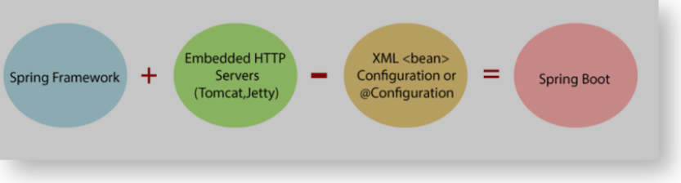
As summarized in the below figure, Spring Boot is the combination of Spring Framework and Embedded Servers.

Slide 5
Spring Boot Architecture
In Spring Boot, there is no requirement for XML configuration (deployment descriptor). It uses convention over configuration software design paradigm which means that it decreases the effort of the developer.
The main goal of Spring Boot is to reduce development, unit test, and integration test time and leveraging the following features:
Create stand-alone Spring applications
Embed Tomcat, Jetty, or Undertow directly (no need to deploy WAR files)

Slide 6
Spring Boot Architecture
Automatically configure Spring whenever possible
Provide production-ready features such as metrics, health checks, and externalized configuration
Absolutely no code generation and no requirement for XML configuration
Provide opinionated ‘starter’ POMs to simplify your Maven configuration

Slide 7
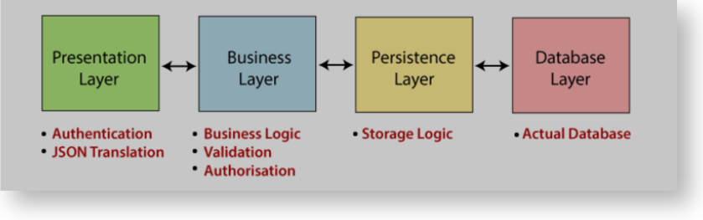
Spring Boot Architecture

Slide 8
Spring Boot Architecture
Presentation Layer: The presentation layer handles the HTTP requests, translates the JSON parameter to object, and authenticates the request, and transfer it to the business layer. In short, it consists of views. Business Layer: The business layer handles all the business logic. It consists of service classes and uses services provided by data access layers. It also performs authorization and validation. Persistence Layer: The persistence layer contains all the storage logic and translates business objects from and to database rows. Database Layer: In the database layer, CRUD (create, retrieve, update, delete) operations are performed.

Slide 9
Spring Boot Architecture
Spring Boot uses all the modules of Spring-like Spring MVC, Spring Data, etc. The architecture of Spring Boot is the same as the architecture of Spring MVC, except for one thing: there is no need for DAO and DAOImpl classes in Spring boot. As a summary, in a simple spring boot flow:
Data access layer gets created and CRUD operations are performed.
The client makes the HTTP requests.
The request goes to the controller, and the controller maps that request and handles it. After that, it calls the service logic if required.
In the service layer, all the business logic performs. It performs the logic on the data that is mapped to JPA with model classes.
A response page is returned to the user if no error occurs.

Slide 10
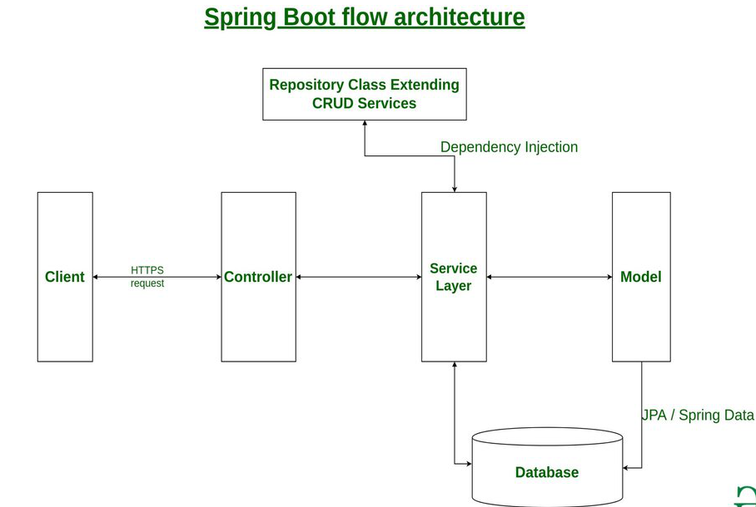
Spring Boot Architecture
The Client makes an HTTP request(GET, PUT, POST, etc.)
The HTTP request is forwarded to the Controller. The controller maps the request. It processes the handles and calls the server logic.
The business logic is performed in the Service layer. The spring boot performs all the logic over the data of the database which is mapped to the spring boot model class through Java Persistence Library(JPA).
The JSP page is returned as Response from the controller.

Slide 11
Spring Boot Starters
Spring Boot starters are dependency descriptors
Dependency: External libraries
Descriptor: Configuration specific JARS and their Versions.
Spring boot starter combines all the necessary libraries for a particular feature or technology into a single dependency.
Example: web.jar, web-MVC.jar, validation.jar, tomcat.jar

Slide 12
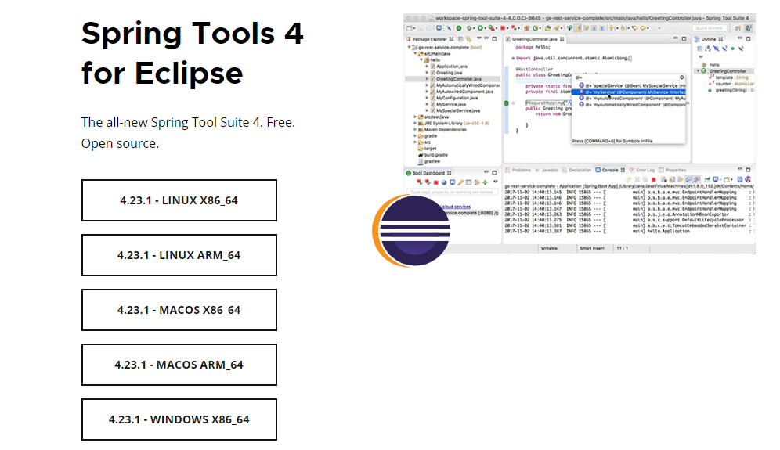
Spring Tool Suite(STS)

Slide 13
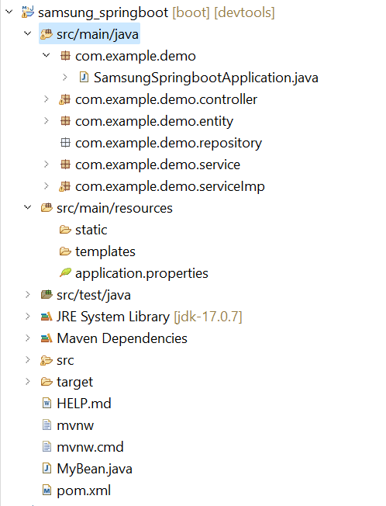
Springboot code Structure
App Name
Source package
Main class
Properties file
Pom file for dependencies

Slide 14
Spring Boot Annotations
Spring Boot Annotations is a form of metadata that provides data about a program. Spring Boot Annotations are mostly placed in the following packages:
org.springframework.boot.autoconfigure
org.springframework.boot.autoconfigure.condition

Slide 15
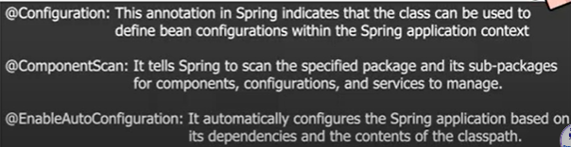
Spring Boot Annotations

Slide 16
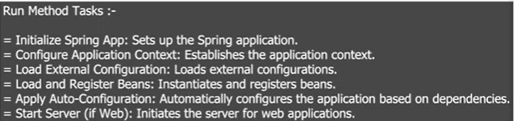
Spring Boot run() method

Slide 17
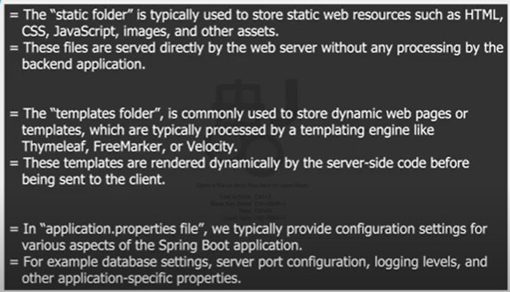
Spring Boot resources folder

Slide 18
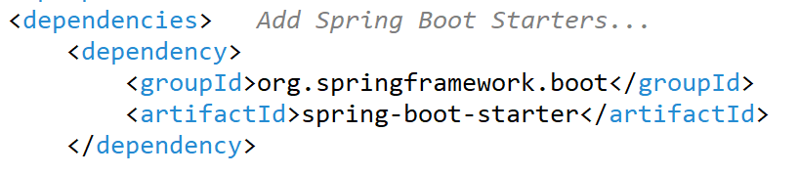
Spring Boot Normal Application “pom.xml”

Slide 19
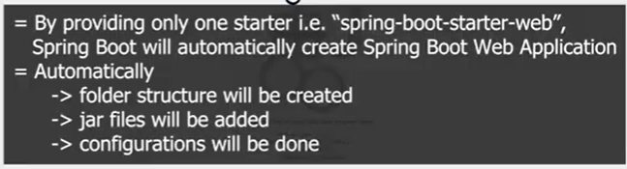
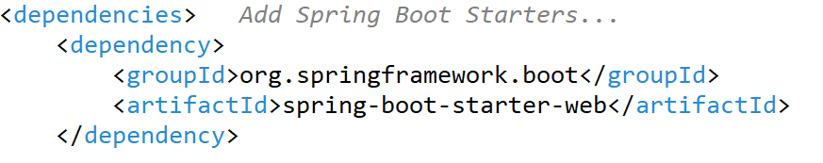
Spring Boot Web Application “pom.xml”

Slide 20
Spring Boot Runners
In Spring Boot, runners are components used to execute code when the application is started. They are typically implemented using Spring's ApplicationRunner or CommandLineRunner interfaces. These runners allow you to perform tasks such as database initialization, data loading, or any custom startup logic.

Slide 21
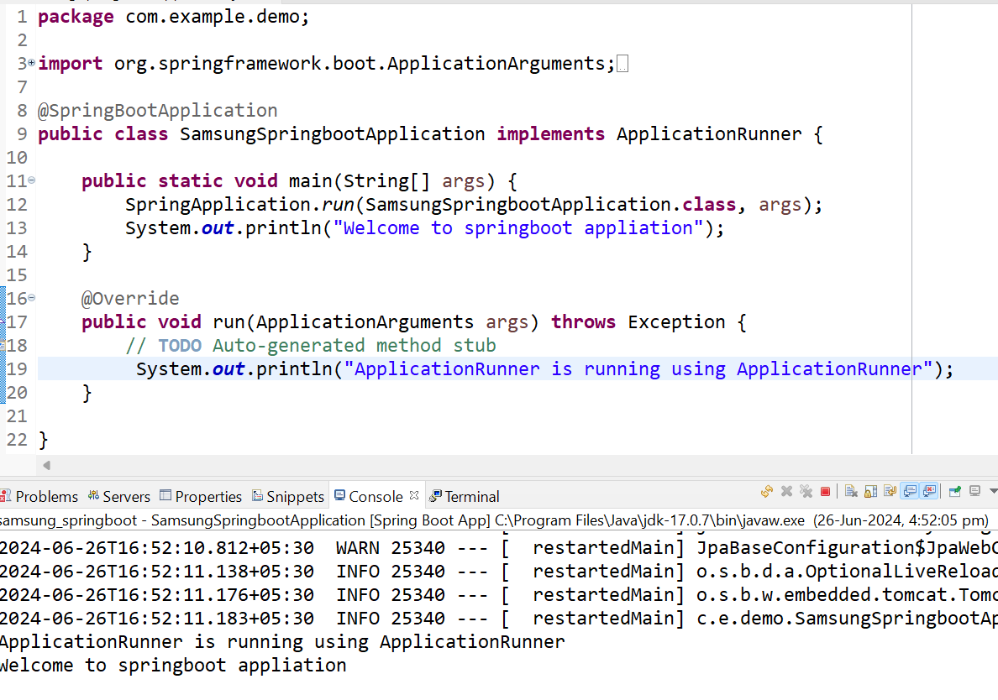
Application Runner
The ApplicationRunner interface in Spring Boot provides a way to execute code after the application context is initialized and before Spring Boot starts servicing incoming requests

Slide 22
CommandLine Runner
Similar to ApplicationRunner, CommandLineRunner is an alternative interface that provides a run method with an array of String arguments. These arguments are passed directly to the application when it is started from the command line.
import org.springframework.boot.CommandLineRunner;
import org.springframework.stereotype.Component;
@Component
public class MyCommandLineRunner implements CommandLineRunner {
@Override
public void run(String... args) throws Exception {
// Code to execute on application startup
System.out.println("CommandLineRunner is running...");
}
}

Slide 23
Springboot Logger
In Spring Boot applications, logging is an essential aspect of monitoring and debugging. Spring Boot integrates with popular logging frameworks like Logback, Log4j2, and Java Util Logging (JUL). Here’s a guide on how to use logging in a Spring Boot application with an example using Logback.
Steps to add Logger in Springboot App
Step1: Add dependency in POM.XML File
<!-- https://mvnrepository.com/artifact/org.slf4j/slf4j-api -->
<dependency>
<groupId>org.slf4j</groupId>
<artifactId>slf4j-api</artifactId>
<version>2.0.13</version>
</dependency>

Slide 24
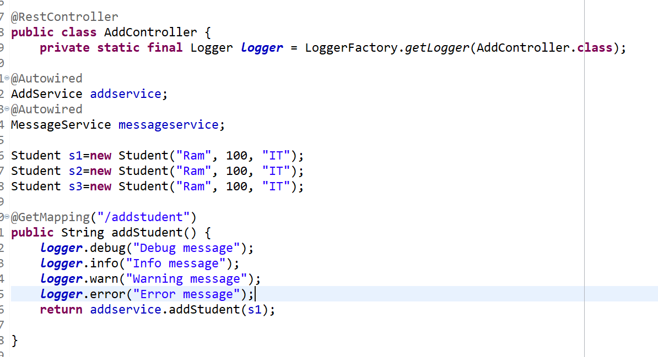
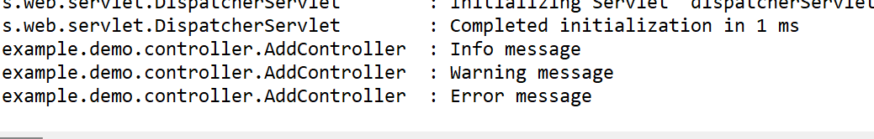



Step2: import relevant package in either Controller , Service or repositories etc.

Slide 25
Example Use Cases
Database Initialization: Load initial data or perform schema setup.
External Service Initialization: Connect to external services or APIs.
Cache Warming: Preload caches on application startup.
Logging: Output informational messages or logs about application state.

Slide 26
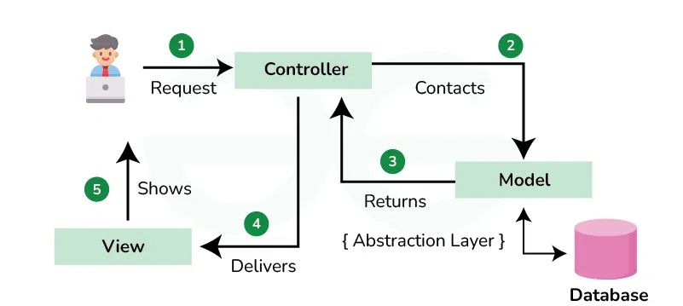
MVC Design Pattern

Slide 27
Restful Web Services
REST stands for REpresentational State Transfer. It is developed by Roy Thomas Fielding, who also developed HTTP. The main goal of RESTful web services is to make web services more effective. RESTful web services try to define services using the different concepts that are already present in HTTP. REST is an architectural approach, not a protocol.

Slide 28
Restful Web Services
It does not define the standard message exchange format. We can build REST services with both XML and JSON. JSON is more popular format with REST. The key abstraction is a resource in REST. A resource can be anything. It can be accessed through a Uniform Resource Identifier (URI). For example:
The resource has representations like XML, HTML, and JSON. The current state capture by representational resource. When we request a resource, we provide the representation of the resource.

Slide 29
Restful Web Services
The important methods of HTTP are:
GET: It reads a resource.
PUT: It updates an existing resource.
POST: It creates a new resource.
DELETE: It deletes the resource.
POST /users: It creates a user.
GET /users/{id}: It retrieves the detail of a user.
GET /users: It retrieves the detail of all users.
DELETE /users: It deletes all users.
DELETE /users/{id}: It deletes a user.
GET /users/{id}/posts/post_id: It retrieve the detail of a specific post.

Slide 30
Restful Web Services
Advantages of RESTful web services
RESTful web services are platform-independent.
It can be written in any programming language and can be executed on any platform.
It provides different data format like JSON, text, HTML, and XML.
It is fast in comparison to SOAP because there is no strict specification like SOAP.
These are reusable.
They are language neutral.

Slide 31
Spring Boot Annotations

Slide 32
1. Spring – REST Controller
RestController: RestController is used for making restful web services with the help of the @RestController annotation. This annotation is used at the class level and allows the class to handle the requests made by the client. Let’s understand @RestController annotation using an example. The RestController allows to handle all REST APIs such as GET, POST, Delete, PUT requests.

Slide 33
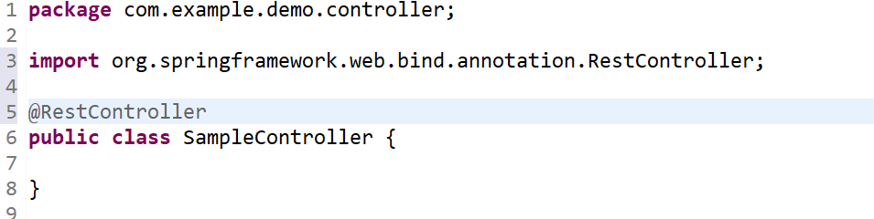
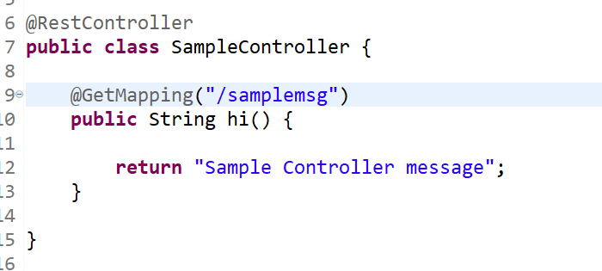
Create a Rest Controller
Create a new package as com.example.demo.controller and create a new class as SampleController , now make this class as RestController using @RestController annotation
Now, Apply @GetMapping annotation to create an end point to access this controller, given below is code:

Slide 34
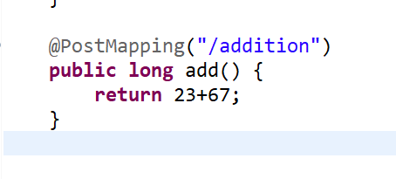
2. PostMapping

Slide 35
3. Spring – Request Body
@RequestBody: Annotation is used to get the request body in the incoming request.

Slide 36
4. Spring – Request Mapping and ResponseBody
@RequestMapping Annotation which is used to map HTTP requests to handler methods of MVC and REST controllers.
The @RequestMapping annotation can be applied to class-level and/or method-level in a controller.
The class-level annotation maps a specific request path or pattern onto a controller.
You can then apply additional method-level annotations to make mappings more specific to handler methods.
@ResponseBody annotation tells a controller that the object returned is automatically serialized into JSON and passed back into the HttpResponse object. When you use the @ResponseBody annotation on a method, Spring converts the return value and writes it to the HTTP response automatically.

Slide 37
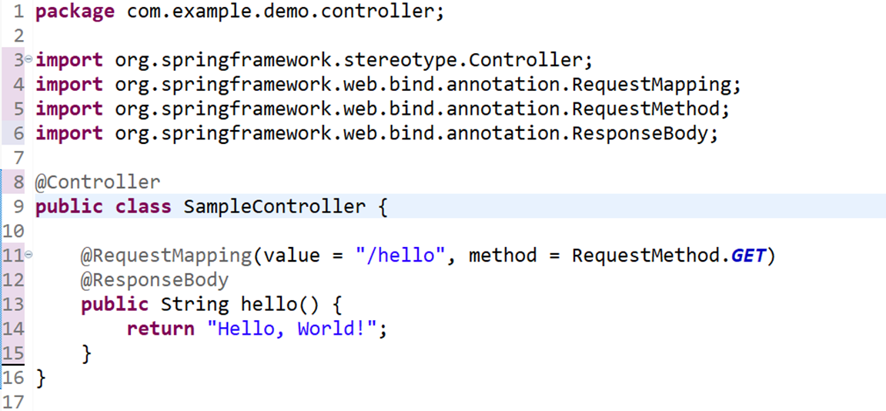
5. Spring – Request Mapping and ResponseBody

Slide 38
6. Spring – PathVariable
The @PathVariable annotation is used to extract the value from the URI. It is most suitable for the RESTful web service where the URL contains some value. Spring MVC allows us to use multiple @PathVariable annotations in the same method. A path variable is a critical part of creating rest resources.
@GetMapping(path="/hello-world/path-variable/{name}")
public HelloWorldBean helloWorldPathVariable(@PathVariable String name)
{
return new HelloWorldBean(String.format("Hello World, %s", name));
}
URL: http://localhost:8080/hello-world/path-variable/ABES O/P- {“message”:”Hello World, ABES”}

Slide 39
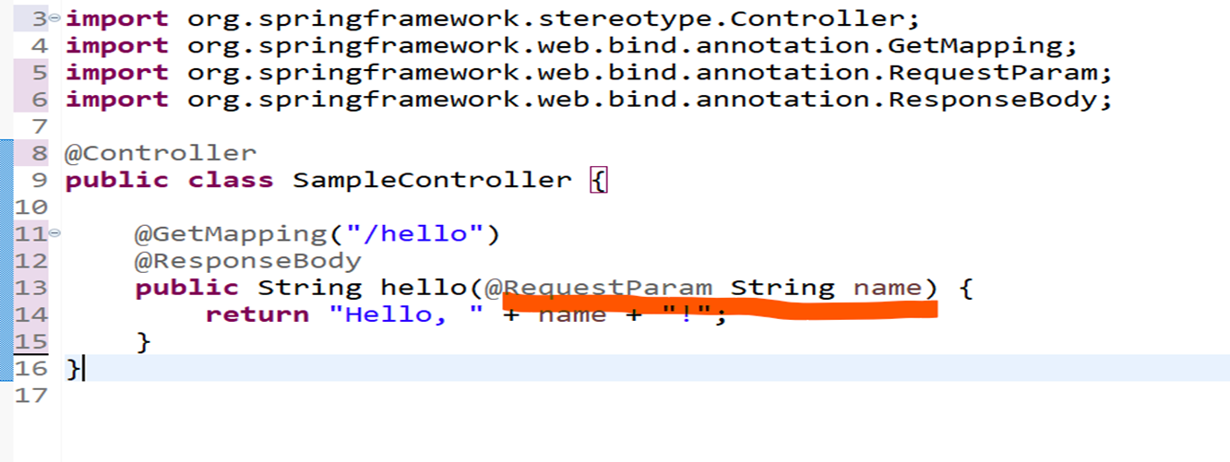
7. Spring – Request Parameter
The @RequestParam annotation is used to extract data from the query parameters in the request URL. Query parameters are the key-value pairs that appear after the ? in a URL.

Slide 40
Rest API
REpresentational State Transfer (REST) is a software architectural style that developers apply to web application programming interfaces (APIs).
REST APIs are the most common APIs used across the web today because the REST pattern provides simple, uniform interfaces. These can be used to make data, content, algorithms, media, and other digital resources available through web URLs, so that they can be consumed within web, mobile, and device applications.

Slide 41
Rest API
let’s consider my own personal Facebook presence, where I am a resource. I can view an HTML representation of my resource at:
GET https://www.facebook.com/prashant.tomer.946/
My profile is a single resource available on Facebook. I can view a representation of that resource in HTML using that URL in my web browser. I can also view another representation of it using the Facebook Graph API.
GET https://graph.facebook.com/v7.0/me

Slide 42
Rest API
This is just one resource Facebook provides, offering up a buffet of digital resources for me to consume as a developer.
Comments: GET https://graph.facebook.com/v7.0/comments
Friends: GET https://graph.facebook.com/v7.0/friends
Images: GET https://graph.facebook.com/v7.0/images
Links: GET https://graph.facebook.com/v7.0/links
Likes: GET https://graph.facebook.com/v7.0/likes

Slide 43
Rest API
This allows for a handful of operations on each resource using HTTP methods:
GET: https://graph.facebook.com/v7.0/images
POST: https://graph.facebook.com/v7.0/images
PUT: https://graph.facebook.com/v7.0/images
DELETE: https://graph.facebook.com/v7.0/images

Slide 44
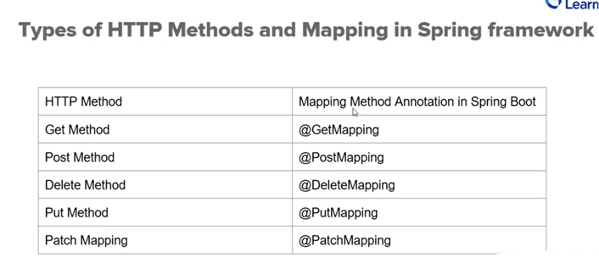



Slide 45
Create Spring boot App using Rest API
Tools Required in this Soring Boot Application:
Eclipse IDE: For project development
Postman Application: Rest API Testing
Spring Boot API: For Spring boot libraries
JDK 8: base of java core development

Slide 46
Steps to Create SpringBoot project and use RestAPI
Step1: Download springboot skeleton from spring initializer.
Step 2: import step1 project in eclipse IDE.
Step3: Open main file where you get main method and run that class as usual do in eclipse to run the normal class.
Step4: Observe the output.

Slide 47
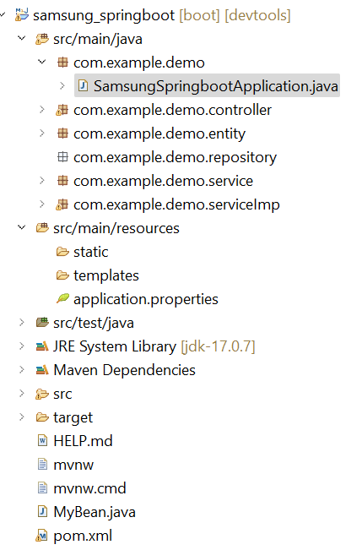
Project Skeleton

Slide 48
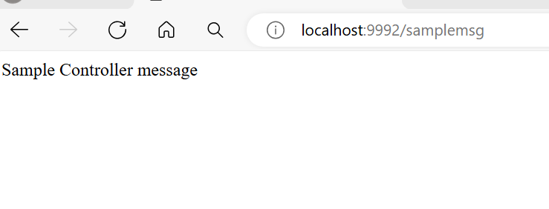
Run Application
To test your REST end point, need to run your springboot application and check on which port your application is running (check console and analyse the output , port number is also there), now go to browser and access using your end point name:

Slide 49
Thank You

